Slide 1
CISC106 – i>clicker
When writing a MATLAB if-statement, the end of the body of the if-statement is determined by:
The end of the indentation
The placement of a semicolon
The placement of a colon
The matching end keyword
The end of the code

Slide 2
CISC106 – i>clicker
When writing a MATLAB if-statement, the end of the body of the if-statement is determined by:
The end of the indentation
The placement of a semicolon
The placement of a colon
The matching end keyword
The end of the code

Slide 3
CISC106 – i>clicker
When writing a MATLAB function, indenting the code in the function is:
Required
Optional
Not Allowed

Slide 4
CISC106 – i>clicker
When writing a MATLAB function, indenting the code in the function is:
Required
Optional
Not Allowed

Slide 5
CISC106 – i>clicker
What is output to the command window by the following MATLAB command?
1 4 7
1 4 7 9
1 3 5 7 9
1 3 9
No output is generated
>> x = 1:3:9;

Slide 6
CISC106 – i>clicker
What is output to the command window by the following MATLAB command?
1 4 7
1 4 7 9
1 3 5 7 9
1 3 9
No output is generated
>> x = 1:3:9;

Slide 7
CISC106 – i>clicker
Which of the following expressions would be an array containing the squares of the values in x?
x * x
x * x’
x .* x
x .* x’
x ^ 2
x = 1:4

Slide 8
CISC106 – i>clicker
Which of the following expressions would be an array containing the squares of the values in x?
x * x
x * x’
x .* x
x .* x’
x ^ 2
x = 1:4

Slide 9
CISC106 – i>clicker
Given the following values for x, y and z, which of the following expressions is valid?
x * z'
x * y
x .* y
z * y'
x ./ z
x = 1:4
y = 5:8
z = 1:10

Slide 10
CISC106 – i>clicker
Given the following values for x, y and z, which of the following expressions is valid?
x * z'
x * y
x .* y
z * y'
x ./ z
x = 1:4
y = 5:8
z = 1:10

Slide 11
LAB 5 (MATLAB)
You may choose to do this lab individually. If you are in engineering, this is recommended, but not required.
Easier than recent labs (but not dramatically).
Take the time needed to learn from the exercises in Lab 5. It will help you on the final exam. If you just burn through as fast as you can, you won’t be well prepared for the final exam.

Slide 12
MATLAB - plotting
House sales in the city "M"
Year
1988
1989
1990
1991
1992
1993
1994
Sales (M)
127
130
136
145
158
178
211
House sales in the city "B"
Year
1988
1989
1990
1991
1992
1993
1994
Sales (B)
137
130
172
204
178
158
141

Slide 13
Finding the Area Under a Curve

Slide 14
Finding the Area Under a Curve

Slide 15
Monte Carlo Methods
A large class of computational algorithms.
Rely on random sampling to obtain numerical results.
Very useful for problems that don’t have a closed form solution.
Often used in optimization and numerical integration.

Slide 16
Estimating Area with Monte Carlo
Suppose we randomly throw darts at the square.
We would expect approximately half the darts to land in the shaded area, and half the darts to land in the unshaded area.
We can count the darts in the shaded region and divide by the total number of darts, to estimate the fraction of the overall area represented by the shaded area.
Area_{rectangle} =
1/1 = 1.0
4/10 = 0.4
2/2 = 1.0
2/3 = 0.67
2/4 = 0.5
3/6 = 0.5
3/5 = 0.6
3/7 = 0.43
3/8 = 0.38
4/9 = 0.44

Slide 17
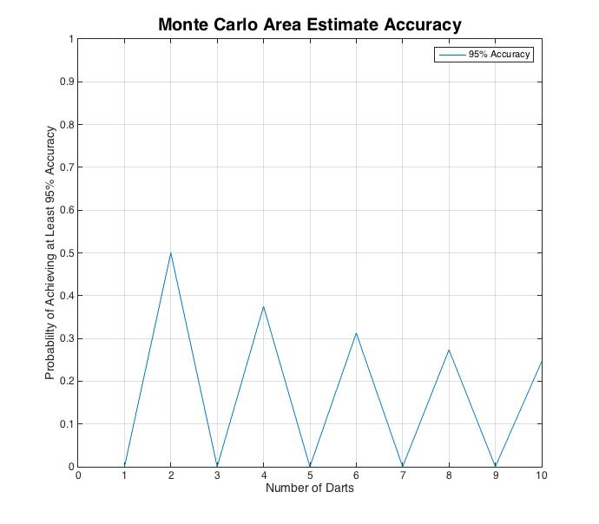

Slide 18
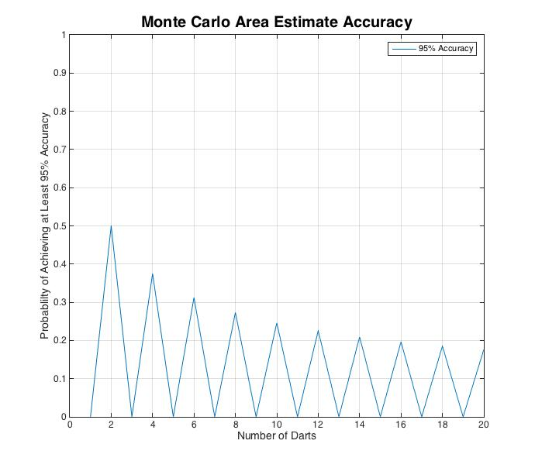

Slide 19
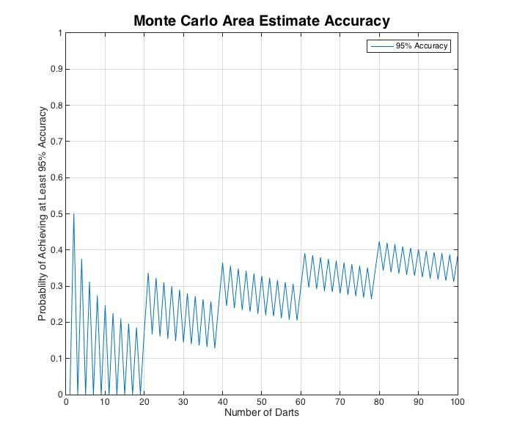

Slide 20
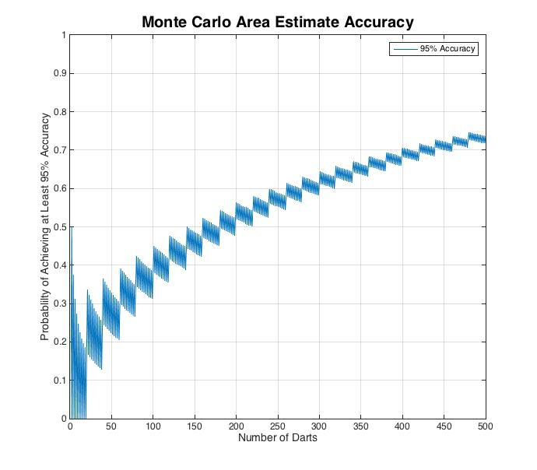

Slide 21
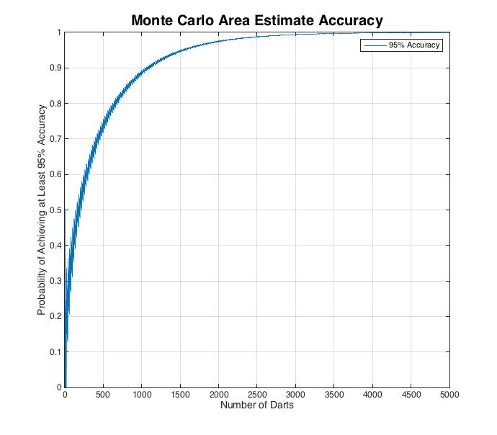

Slide 22
